Slide 1
Customer Record Audit/Resend (CRA/CRR) (Service Maintenance folder)
The SMS/800 Customer Record Audit/Resend (CRA/CRR) window is used to perform the following:
A. CRA - Compare the CR information in SMS/800 with the CR information in the SCPs. A snapshot of the SMS/800 record is compared with a snapshot of the SCP record. Results are sent to email listed on URC.
B. CRR - Resend customer records to SCPs
C. DELETE - Delete customer records from selected SCPs that are outside AOS.
SMS/800 ® is a registered trademark of SMS/800, Inc.
Notes:
The SMS/800 Customer Record Audit/Resend (CRA/CRR) window is used to perform the following:
(Click)
A. CRA - Compare the CR information in SMS/800 with the CR information in the SCPs. A snapshot of the SMS/800 record is compared with a snapshot of the SCP record. Results are sent to email listed on URC.
(Click)
B. CRR - Resend customer records to SCPs
(Click)
C. DELETE - Delete customer records from selected SCPs that are outside AOS.

Slide 2
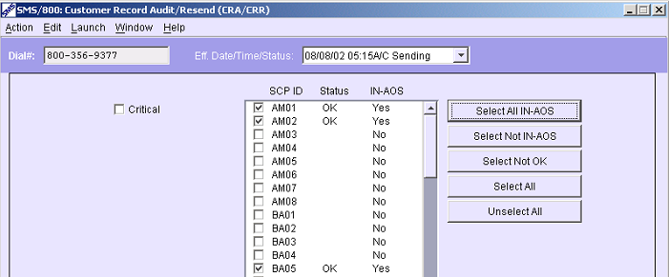
CRA/CRR – Menu Items
Action – Same as buttons: (Retrieve, Audit…)
Edit – (Help Desk Only)
Launch – Opens the CAD, CPR or LAD of the CRA/CRR record.
Window – Displays the Open windows of the current CR.
Notes:
CRA/CRR Menu Items…
(Click)
Action – Same as buttons: (Retrieve, Audit, etc…)
Edit – (Help Desk Only)
Launch – Opens the CAD, CPR or LAD of the CRA/CRR record.
Window – Displays the Open windows of the current CR.

Slide 3
CRA/CRR – Critical and SCPs
Critical - An audit, resend, or delete is sent, even if an SCP overload exists.
SCP ID – Service Control Point IDs.
Status – Status of Customer Record at SCP.
IN-AOS – Is the SCP in the Area of Service.
Select All IN-AOS – Select all the SCPs in the Area of Service.
Select Not IN-AOS – Select all the SCPs not in the Area of Service.
Select Not OK – Select all the SCPs in the Area of Service, that are not
listed as OK.
Select All – Select all the SCPs.
Unselect All – Unselect all the SCPs.
Notes:
The fields of the CRA include:
(Click)
Critical – If checked, An audit, resend, or delete is sent, even if an SCP overload exists.
(Click)
SCP ID – Service Control Point IDs.
(Click) (Click) (Click)
Status – Status of Customer Record at SCP.
(Click) (Click) (Click)
IN-AOS – Is the SCP in the Area of Service.
(Click) (Click) (Click)
Select All IN-AOS – Select all the SCPs in the Area of Service.
(Click) (Click) (Click)
Select Not IN-AOS – Select all the SCPs not in the Area of Service.
(Click) (Click) (Click)
Select Not OK – Select all the SCPs in the Area of Service, that are not listed as OK.
(Click) (Click) (Click)
Select All – Select all the SCPs.
(Click) (Click) (Click)
Unselect All – Unselect all the SCPs.
(Click) (Click) (Click)

Slide 4
Most Frequent SCP Statuses
01 – Syntax error rejected
31 – CMSDB error rejected
LO – Loading SCP
NU – Not queued SCP unavailable
OK – Update OK
QN – Queued no response
QO – Queued overload
QU – Queued SCP unavailable
SE - Sending
Notes:
The most frequent SCP statuses codes found in the Status column of CRA Are:
(Click)
01 – Syntax error rejected – Something wrong with the record
(Click)
31 – CMSDB error rejected – Record is too large
(Click)
LO – Loading SCP – SCP is loading records
(Click)
NU – Not queued SCP unavailable – Off line SCP with no Que
(Click)
OK – Update OK – Loaded and OK response sent to SMS
(Click)
QN – Queued no response – Que with no response from SMS
(Click)
QO – Queued overload – Overload at SCP with a large Que
(Click)
QU – Queued SCP unavailable – SCP offline with a Que
(Click)
SE – Sending – Record sent to SCP but no response to SMS yet.
(Click)

Slide 5
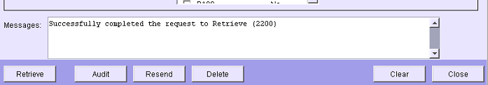
CRA/CRR - Action Buttons
Audit – Used to compare the customer record in the SMS/800 Database to the selected SCPs. The results will sent to the users SMS/800 mailbox as set up on URC/ROP.
Resend – Used to resend the SMS/800 Database customer record to the selected SCPs.
Delete – Used to delete the customer record from the selected SCPs.
Note: The retrieved customer record must have a status of:
Active, Sending or Disconnect
Notes:
CRA/CRR Unique Action Buttons
(Click)
Audit – Used to compare the customer record in the SMS/800 Database to the selected SCPs. The results will sent to the users SMS/800 mailbox as set up on URC/ROP.
(Click) (Click)
Resend – Used to resend the SMS/800 Database customer record to the selected SCPs.
(Click)(Click)
Delete – Used to delete the customer record from the selected SCPs.
(Click)(Click)
Note: The retrieved customer record must have a status of:
Active, Sending or Disconnect

Slide 6
Audit, Resend, or Delete a Customer Record
Open the CRA/CRR from the Main Menu.
Type the Dial # in the Dial# field.
Press the Retrieve button. --OR-- From the CAD select Menu “Launch” then CRA/CRR.
Check the SCP IDs to Audit, Resend, or Delete.
Press the corresponding button.
Read the results of the Audit in the e-mail box designated on the URC/ROP screen (first tab).
Notes:
The steps to Audit, Resend or Delete a CR from SCPs follow:
(Click)
1. Open the CRA/CRR from the Main Menu.
(Click)
2. Type the Dial # in the Dial# field.
(Click)
3. Press the Retrieve button. --OR-- From the CAD select Menu “Launch” then CRA/CRR.
(Click)
4. Check the SCP IDs to Audit, Resend, or Delete.
(Click)
5. Press the corresponding button.
(Click)
6. Read the results of the Audit in the e-mail box designated on the URC/ROP screen (first tab).
(Click)

Slide 7
Email Results from a CRA
Notes:
Email results from a CRA display as follows:
(Click)

Slide 8
Routing Canada
In 1994 Canada joined with SMS/800
Rules for routing to Bell Canada SCP (or BX01 will reject CR)
a. Only CICs that are recognized by Bell Canada, as being valid, will be accepted by the Bell Canada SCP - BX01. (See Extras Tab page 84)
b. BX01 will reject the following Scenarios: Multiple Carrier Canadian CPR Rows, Canadian CPR destination number being a POTS#.
Because the Canadian SCP BX01 will reject the above record scenarios, upon Update the Record will change to INVALID and will have to be corrected.
Notes:
In 1994 Canada joined their SMS/800 with The United States SMS/800
(Click)
Rules for routing to Bell Canada SCP (or BX01 will reject CR)
(Click)
Only CICs that are recognized by Bell Canada, as being valid, will be accepted by the Bell Canada SCP - BX01. (See Extras Tab page 80)
(Click)
BX01 will reject the following Scenarios: Multiple Carrier Canadian CPR Rows, Canadian CPR destination number being a POTS#.
(Click)
Because the Canadian SCP BX01 will reject the above record scenarios, upon Update the Record will change to INVALID and will have to be corrected.

Slide 9
Safe Way to Route Canada on CPR
888 = All Canada (One Row to Dial#)
Other = All Canada + ? (One Row to Dial#)
Notes:
The Safe way to Route Canada on the CPR is as follows:
(Click)
Use Lata as first column and enter the one Canadian LATA 888 (one row) pointing to a valid Canadian Carrier to the Dial# turnaround.
(Click)
Using the word Other to contain all of the Canadian routing on 1 row of the CPR.
(Click)

Slide 10
Size Limits and CPU Utilization
CR Size Limitation – The SCPs have a CR limit of 170,000 bytes. SMS/800 may allow a record to go Pending even though it is too large. But, when it is sent to the SCPs the CRA/CRR may display a 31 status. The CR status will be FAILED and the record will have to be reduced in size. The actual size will then be sent to the Generic Email in a FAILED customer record message. The CRS screen will allow you to look up the size of a CR.
CPU Usage limitation – A Resp Org is not allowed to use more than its fair share of the total SMS/800 CPU at any one time. Serious consequences may result.
(The CRS screen will also show how many records of this size can be sent during a 1 hour period) (See next Slide)
Notes:
Important information concerning CR Size limits and CPU Utilization limits in SMS/800.
(Click)
CR Size Limitation – The SCPs have a CR limit of 170,000 bytes. SMS/800 may allow a record to go Pending even though it is too large. But, when it is sent to the SCPs the CRA/CRR may display a 31 status. The CR status will be FAILED and the record will have to be reduced in size. The actual size will then be sent to the Generic Email in a FAILED customer record message. The CRS screen will allow you to look up the size of a CR.
(Click)
CPU Usage limitation – A Resp Org is not allowed to use more than its fair share of the total SMS/800 CPU at any one time. Serious consequences may result.
(Click)
(The CRS screen will also show how many records of this size can be sent during a 1 hour period) (See next Slide)
(Click)

Slide 11
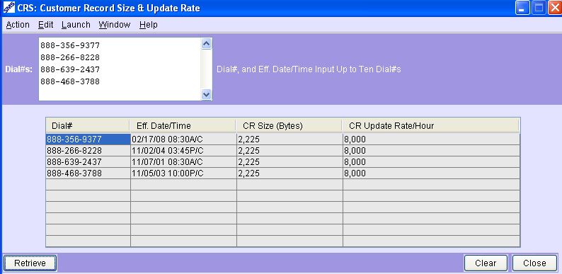
CRS Screen
Recommended to stay under 80% of Max rate.
(I.e. In 1 hour of time only Update 6400 records {80% of 8,000} with CR size of 2,225 Bytes)
Notes:
(Click)
The CRS screen allows a user to look up the size of up to 10 Dial#s in a single Retrieve. It’s important that a RO follow the guidelines for Record updates.
(Click)
The results show the Dial#, Eff/date and time, Cr size and maximum CR Update per hour.
(Click) (Click)
Each of these records show as 2,225 bytes in size.
(Click)
Resp Orgs are Recommended to stay under 80% of Max rate.
(I.e. In 1 hour of time only Update 6400 records {80% of 8,000} with CR size of 2,225 Bytes)

Slide 12
CRA/CRR Review
CRA definition – Audit, SMS, SCPs
CRA tasks - Compare
CRR definition – Resend, SCPs
CRR tasks – Resend, Delete
CRS – CR size and Update rate
Written Exercise CRA/CRR #10
Hands-On Exercise CRA/CRR (10A)
Notes:
Please complete the written and Hands On Exercises.

